Slide 1
Prediction and Data Visualization of Sepsis
Yihan Li (yl10798), Yantao Luo (yl5929)
Notes:
Good evening, everyone! Next, we would like to introduce our project on the prediction and data visualization of Sepsis. I am Yihan Li, and this is my partner Yantao Luo.

Slide 2
Introduction
What’s Sepsis
The complexity of sepsis:
Sepsis is a kind of severe blood poisoning caused by a systemic inflammatory response to infection (Gyawali et al., 2019).
No specific indicators for the occurrence of sepsis
48.9 million cases and 11 million deaths in 2017 (Rudd et al., 2017).
The critical need for early detection to improve survival rates and prevent organ damages.
Notes:
First of all, about sepsis.
it is a kind of severe blood poisoning caused by a systemic inflammatory response to infection.
There are no specific signs that indicate the occurrence of Sepsis.
Because of its complexity, there were about 50 million cases and about 11 million sepsis-related deaths reported in the year of 2017.
Therefore, it is a critical need for an effective early detection methods to improve survival rates and to prevent organ damages.

Slide 3
Introduction
Dataset
Comprehensive clinical dataset designed to challenge and enable sepsis prediction before clinical awareness [1].
Dataset includes:
Vital Signs: HR, O2Sat, Temp, SBP, MAP, DBP, Resp, EtCO2.
Laboratory Values: Blood pH, PaCO2, and more.
Demographics: Age, Gender, ICU identifiers, ICU admission times, ICU stay duration.
Outcome: SepsisLabel indicating sepsis onset within a specific time frame.
[1] LAKSHYA SONI. 2022.Sepsis prediction. Kaggle. Retrieved December 5, 2023 from https://www.kaggle.com/code/lakshyasoni97/sepsis-prediction
Notes:
We retrieved our dataset from Kaggle. It’s a comprehensive clinical dataset designed to challenge and enable sepsis prediction before clinical awareness.
The dataset includes a number of vital signs, lab values, and some demographic information.
The independent variable is SepsisLabel, where 1 means a positive Sepsis case, 0 means it’s not a sepsis case.

Slide 4
Introduction
Our Contribution
Created a set of data visualization for clinical insights into sepsis indicators
Development of predictive models to assist healthcare professionals
Full code repository made publicly available for transparency and collaboration
Notes:
We have several contributions in this project: first, we created a set of data visualizations for clinical insights into sepsis indicators;
we also developed three predictive models to assist healthcare professionals to filter sepsis cases.
And we have our full code repository public on github.

Slide 5
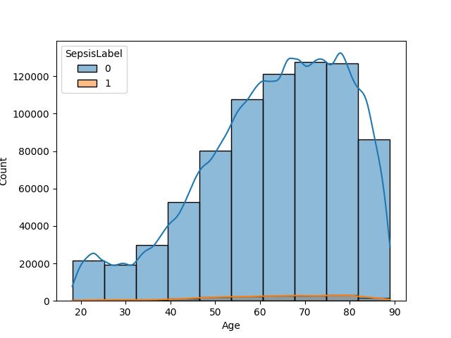
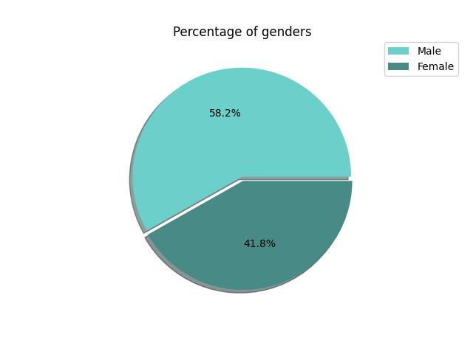
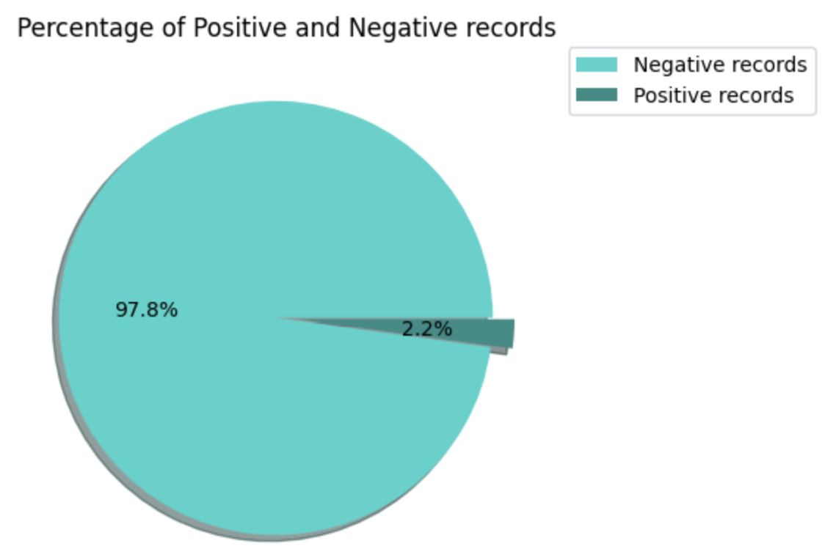
Methodology
Data Analysis
Exploratory Data Analysis
Reviewed 790,215 records across 43 columns from 20,336 patients.
Identified 2.2% of records as sepsis cases, highlighting dataset imbalance.
Notes:
Next, for the methodology part, we first did a thorough data analysis.
Our dataset contains about 80 thousand records across 43 columns from 20 thousand patients.
Among those patients, about 58 % of them are male, 42% of them are female. And most of them are aged from 40 to 90.
About 2.2 % of the records are sepsis cases, which means our dataset is highly imbalanced. This is one of the major challenges in our project.

Slide 6
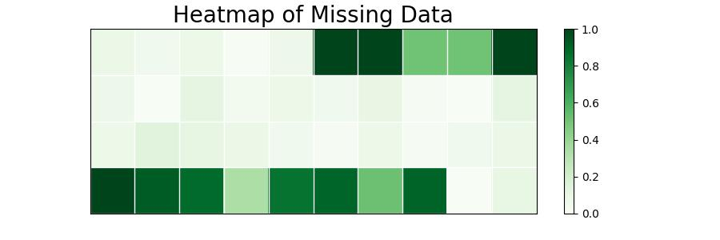
Methodology
Data Analysis
Addressing Nullity
Noted high levels of missing data, averaging 65.04% null values.
Notes:
Moreover, we have 65 % of missing data in our dataset.
Here is a heatmap of missing data, and lighter color denotes high proportion of missing data.
We can see that many of the features have less than 20 % of valid data. This is the second challenge.

Slide 7
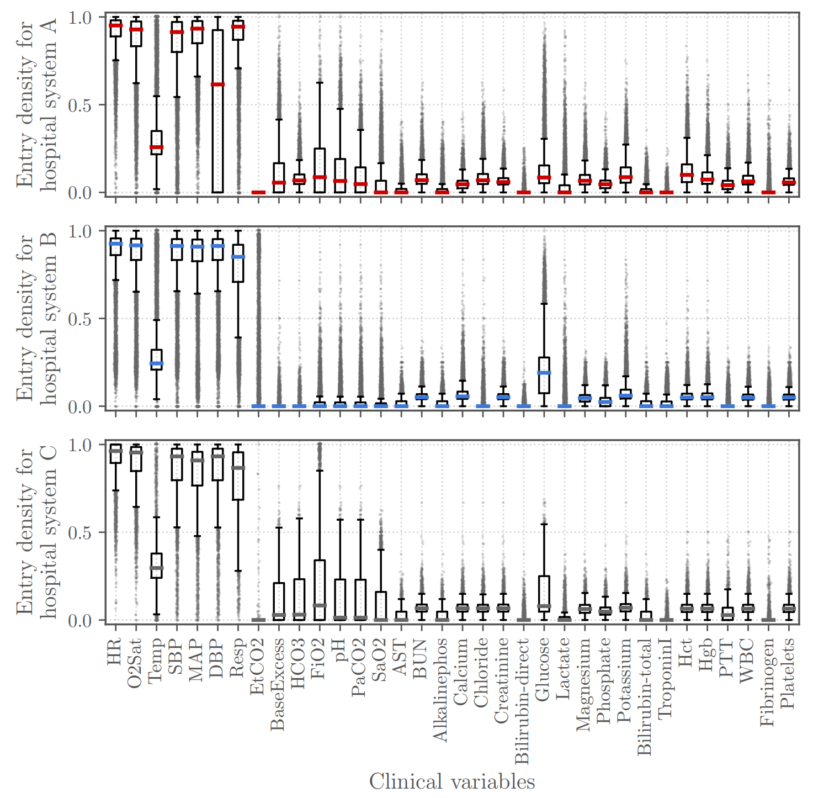
Methodology
Data Analysis
Outlier Management
We refer to the box plot of the original dataset
Image source: (Reyna, et al., 2020)
Notes:
To analysis the outliers, we refer to the box plot of the original dataset.
In this figure, we can see that there are a lot of outliers. Besides, some of the features do not conform to the normal distribution.
So we performed log transformation to those features later to make sure they fit a normal distribution.

Slide 8
Methodology
Data Analysis
Feature Selection
Analyzed a correlation matrix to evaluate the relationship between features and “SepsisLabel”.
Notes:
To select features, we also analyzed a correlation matrix to evaluate the relationship between features and the independent variable “SepsisLabel”.

Slide 9
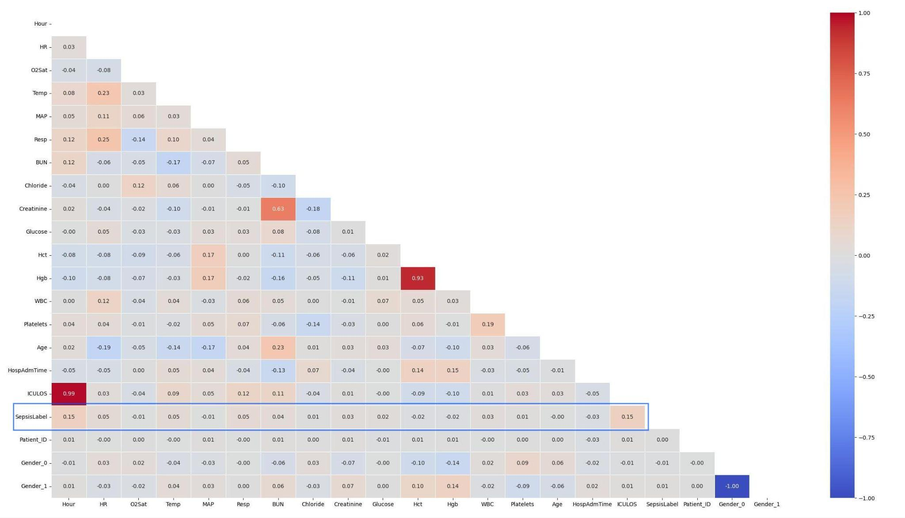
Methodology
Data Analysis
Feature Selection
Analyzed a correlation matrix to evaluate the relationship between features and “SepsisLabel”.
Notes:
This row is the correlation between features and our label.
All of the features shows a low correlation to the label. So we decided to keep them all.
Some pairs like Hour and ICULOS, and Hgb and Hct are highly related. We just kept one feature of each pair.

Slide 10
Methodology
Data Preprocessing
Normalization
Log transformation and standard scaling for feature uniformity.
Outlier Management
Z-score filtering to maintain data integrity.
Two-stage Imputation
1. Forward and backward filling within patient groups regarding temporal continuity.
2. Further impute with mean values within patient groups.
Notes:
For the data preprocessing, we performed log transformation to some of the log-scale features and then did a standard scaling.
We filtered the outliers using a threshold of z-score equals to 3.
To tackle the issue of missing data, we adopted a two-stage imputation. We first impute the missing data with forward and backward filling, which duplicate the data from the last or next records. This approach utilized the temporal continuity of lab signs of patients. However, this approach cannot fill out all of the blanks. We further impute with mean values. Note that all of the imputation operation should be performed within patient groups.

Slide 11
Methodology
Data Preprocessing
Dataset Split
80/20 training/test split for robust model validation.
Class Balancing
Applied SMOTEENN to balance the dataset (Batista et al., 2005).
Notes:
We split the dataset into training set and test set. To handle the problem of imbalanced data, we applied SMOTEENN resampling method. This method mainly utilized k nearest neighbors information to resample on the minority class. My teammate will introduce the model and result part.

Slide 12
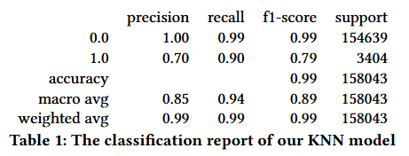
Results Overview
K-Nearest Neighbors
High accuracy demonstrated at 99%, indicating strong overall predictive capability.
Precision for sepsis cases (class 1.0) at 70% suggests moderate reliability in positive predictions.
Recall for sepsis cases at 90% indicates a high ability to detect true sepsis cases.
F1-score at 0.79 for sepsis class reflects a balance between precision and recall, though room for improvement.

Slide 13
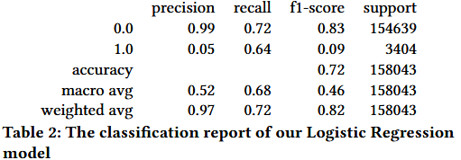
Results Overview
Logistic Regression
Achieved 72% accuracy, indicating satisfactory predictive power.
Sepsis prediction precision at 5% reveals a challenge in false positive reduction.
Sepsis prediction recall at 64% shows a reasonable detection rate for true sepsis cases.
F1-score for sepsis at 0.09, highlighting a critical area for improvement in balancing precision and recall.
Notes:
Logistic Regression is a linear model with less capacity to capture complex patterns and interactions between features compared to Random Forest, which is a highly flexible, non-linear model that can handle intricate interactions well. KNN also has the ability to capture non-linearities by considering the proximity of data points in the feature space.

Slide 14
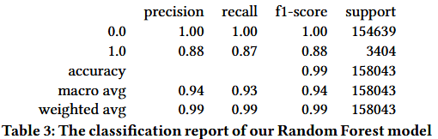
Results Overview
Random Forest
Exhibited robust performance with 88% accuracy across both sepsis and non-sepsis classes.
High precision (88%) and recall (87%) for sepsis cases, indicating strong predictive accuracy with minimal false positives/negatives.
Balanced F1-score of 0.88 for sepsis class demonstrates the model's effectiveness in sepsis detection.
Overall model performance suggests Random Forest as a potentially reliable tool for early sepsis prediction in clinical settings.

Slide 15
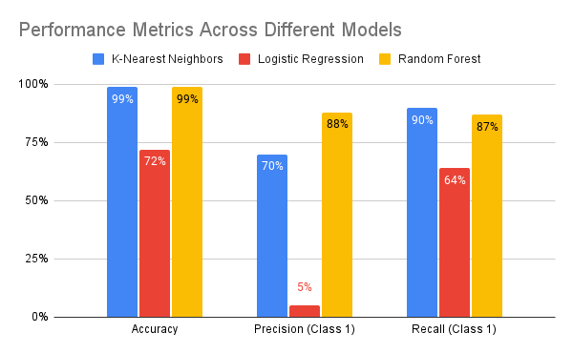
Results Overview
Comparison

Slide 16
Discussion and Implications
Model Integration: Explored the integration of machine learning models into clinical workflows, highlighting the need for careful interpretation alongside professional judgment.
Performance Enhancement: Discussed strategies for model improvement, such as incorporating granular clinical data and advanced feature engineering.
Model Generalization: Emphasized the importance of validating models with diverse, up-to-date datasets to ensure broad applicability and resilience against overfitting.

Slide 17
Conclusions
Advancing Sepsis Prediction: Demonstrated promising results in sepsis detection using KNN, Logistic Regression, and Random Forest models.
Clinical Relevance: Highlighted the potential of these models to enhance early sepsis identification in clinical settings, thus improving patient care.
Model Limitations: Acknowledged the need to address class imbalance and refine false positive rates for greater accuracy.

Slide 18
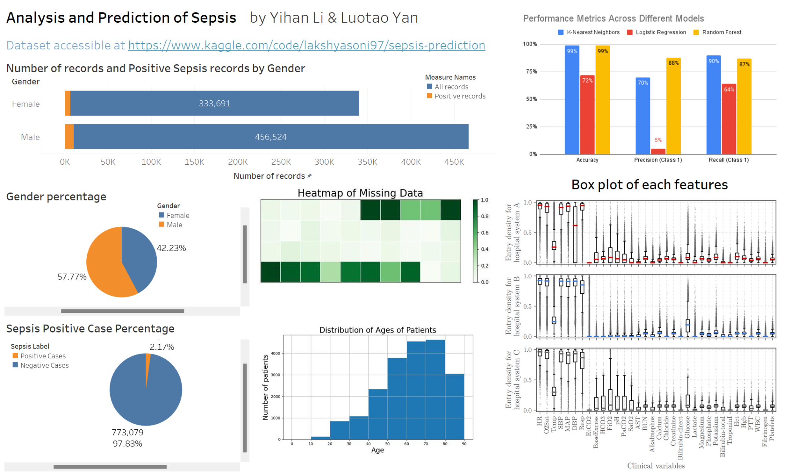

Slide 19
References
Batista, G. E., Prati, R. C., & Monard, M. C. (2005, September). Balancing strategies and class overlapping. In International symposium on intelligent data analysis (pp. 24-35). Berlin, Heidelberg: Springer Berlin Heidelberg.
Gyawali, B., Ramakrishna, K., & Dhamoon, A. S. (2019). Sepsis: The evolution in definition, pathophysiology, and management. SAGE open medicine, 7, 2050312119835043.
Reyna, M. A., Josef, C. S., Jeter, R., Shashikumar, S. P., Westover, M. B., Nemati, S., ... & Sharma, A. (2020). Early prediction of sepsis from clinical data: the PhysioNet/Computing in Cardiology Challenge 2019. Critical care medicine, 48(2), 210-217.
Rudd, K. E., Johnson, S. C., Agesa, K. M., Shackelford, K. A., Tsoi, D., Kievlan, D. R., ... & Naghavi, M. (2020). Global, regional, and national sepsis incidence and mortality, 1990–2017: analysis for the Global Burden of Disease Study. The Lancet, 395(10219), 200-211.
LAKSHYA SONI. (2022).Sepsis prediction. Kaggle. Retrieved December 5, 2023 from https://www.kaggle.com/code/lakshyasoni97/sepsis-prediction

